Slide 1
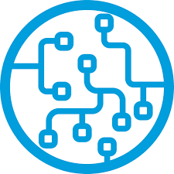
Hello World! We’ll be starting momentarily.
Please mute yourselves during the presentation. If you have any questions or troubleshooting issues during the event, please use the chat function or wait for the Q/A session at the end.
Intro To
Machine Learning BC HACKS 2.0 | DSC UBC February 18, 2021 - 5:00PM PST

Slide 2
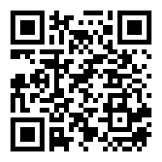

University of British Columbia
Google Developer Student Clubs (DSC) is a program sponsored by Google Developers. DSCs are university based community groups for students. It offers:
Peer-to-Peer learning
Free certifications through Qwiklabs and Google Cloud Platform
Networking with mentors, developer leads and other entities within the community.
Scan QR Code to Sign up

Slide 3



Find a solution to a problem in your community
Form a group of 4 to create a project using Google technologies that execute your solution
International competition with regional winners
UN’s 17 Goals
Solution Challenge
@dscubc ubcdsc.com
Notes:
What is the solution Challenge?
Google challenges DSCs to find solutions
Local communities,
Student communities
Personal communities

Slide 4



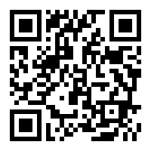
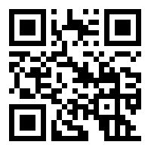
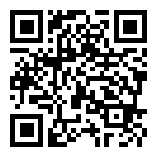
Gagan Bhatia
Richard Tian
Justin Chan

Slide 5
Machine Learning Workshop
Today we’ll cover:
Introduction to concepts
Basics of ML and NLP
Experimenting with HuggingFace Transformers
Deploying ML WebApps with Streamlit

Slide 6
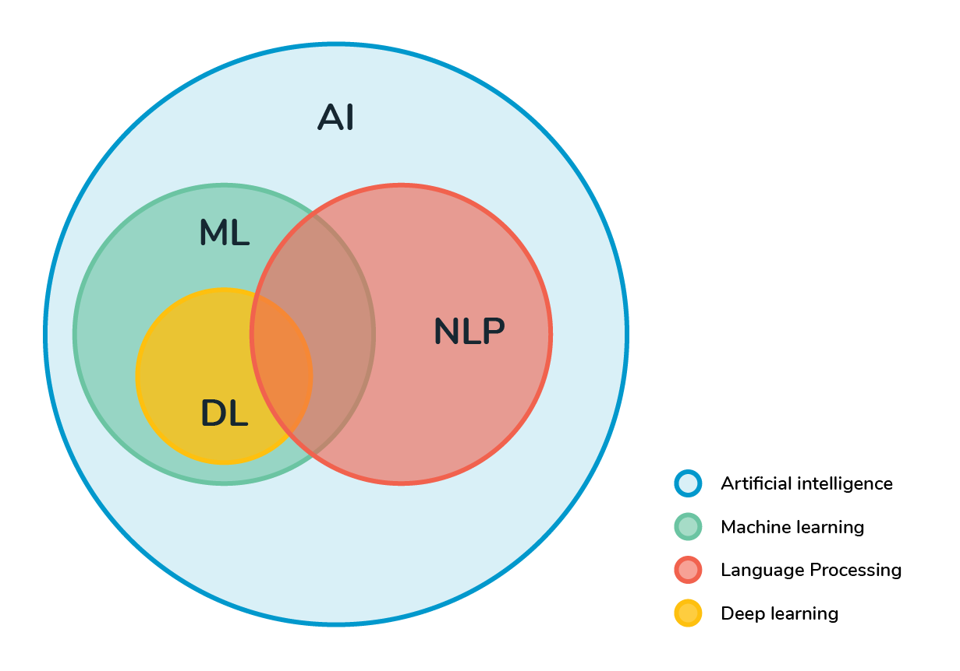
Workshop Concepts
Workshop Prerequisites:
Python Basics and Jupyter Notebooks
AI & Machine Learning
NLP - Natural Language Processing
ML Models - Training, Pre-training, Supervised, Etc.
Transformer
Tech: Tensorflow, PyTorch, Streamlit,
HuggingFace Transformers
Notes:
We’ll

Slide 7
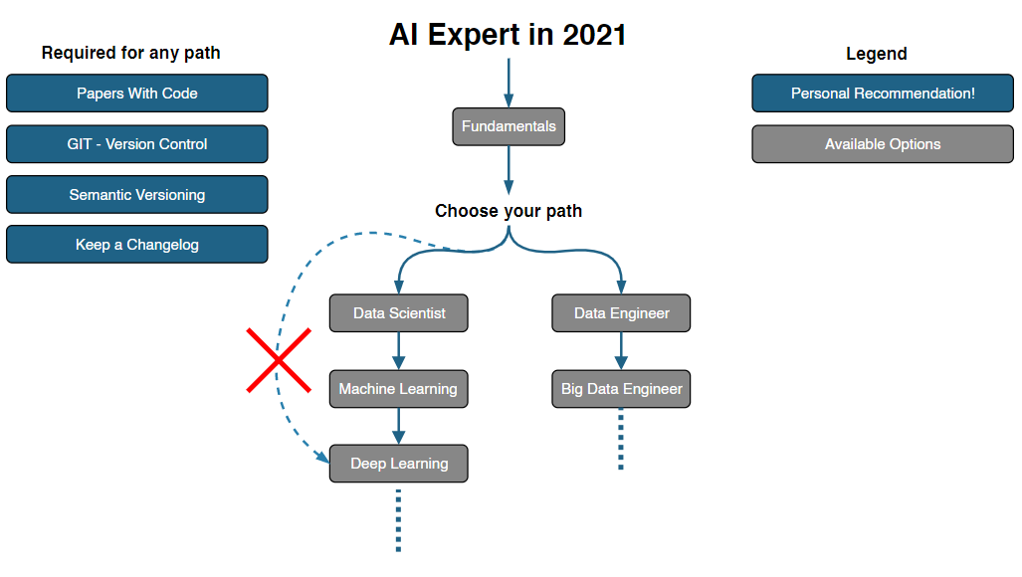
Understanding The
Scope of AI & ML
https://i.am.ai/roadmap/
Our workshop focuses on using “surface-level” tools to implement ML functions in your own projects.
The field of ML itself is just a subset of AI
While ML has been made accessible through different tools and open source projects, understanding how ML works is an extensive process.

Slide 8
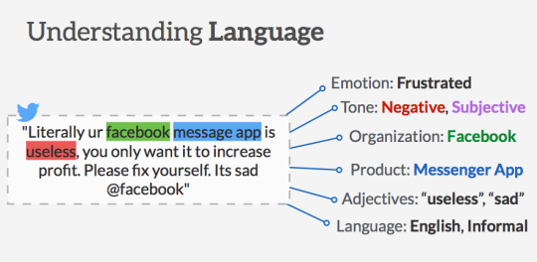
ML and NLP
Machine learning (ML) for natural language processing (NLP) and text analytics involves using machine learning algorithms and “narrow” artificial intelligence to understand the meaning of text documents.
Computers tend to deal with structured data. They have a hard time with unstructured data:
social media, news, emails, ect.
NLP is used to parse through unstructured data to extract useful information. ML is used to automate this process and deliver accurate responses through learning from past interactions.
Example Use Cases
Sentiment Analysis - Stock Trends
Q&A - Help Desk
Chatbots - Automation
Summarization - tldr

Slide 9

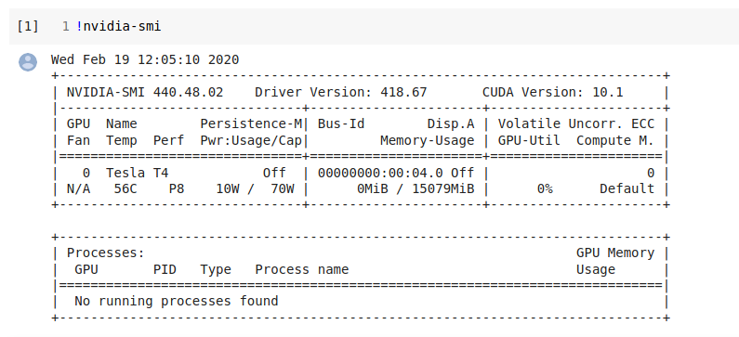
Google Colab
Pre-Installed Libraries - Pandas, NumPy, Matplotlib
Saved on the Cloud- Think Google Docs but for ML
Collaboration- Super Easy to Share Notebooks
Free GPU and TPU Use - Nvidia K80 / T4 12GB / 16GB

Slide 10

Hugging Face
Democratizing NLP, one commit at a time!
Hugging Face is an NLP-focused startup with a large open-source community, in particular around the Transformers library.
Transformers is based around the concept of pre-trained transformer models.
The advantage of using Transformers lies in the straight-forward model-agnostic API.
pip install transformers

Slide 11

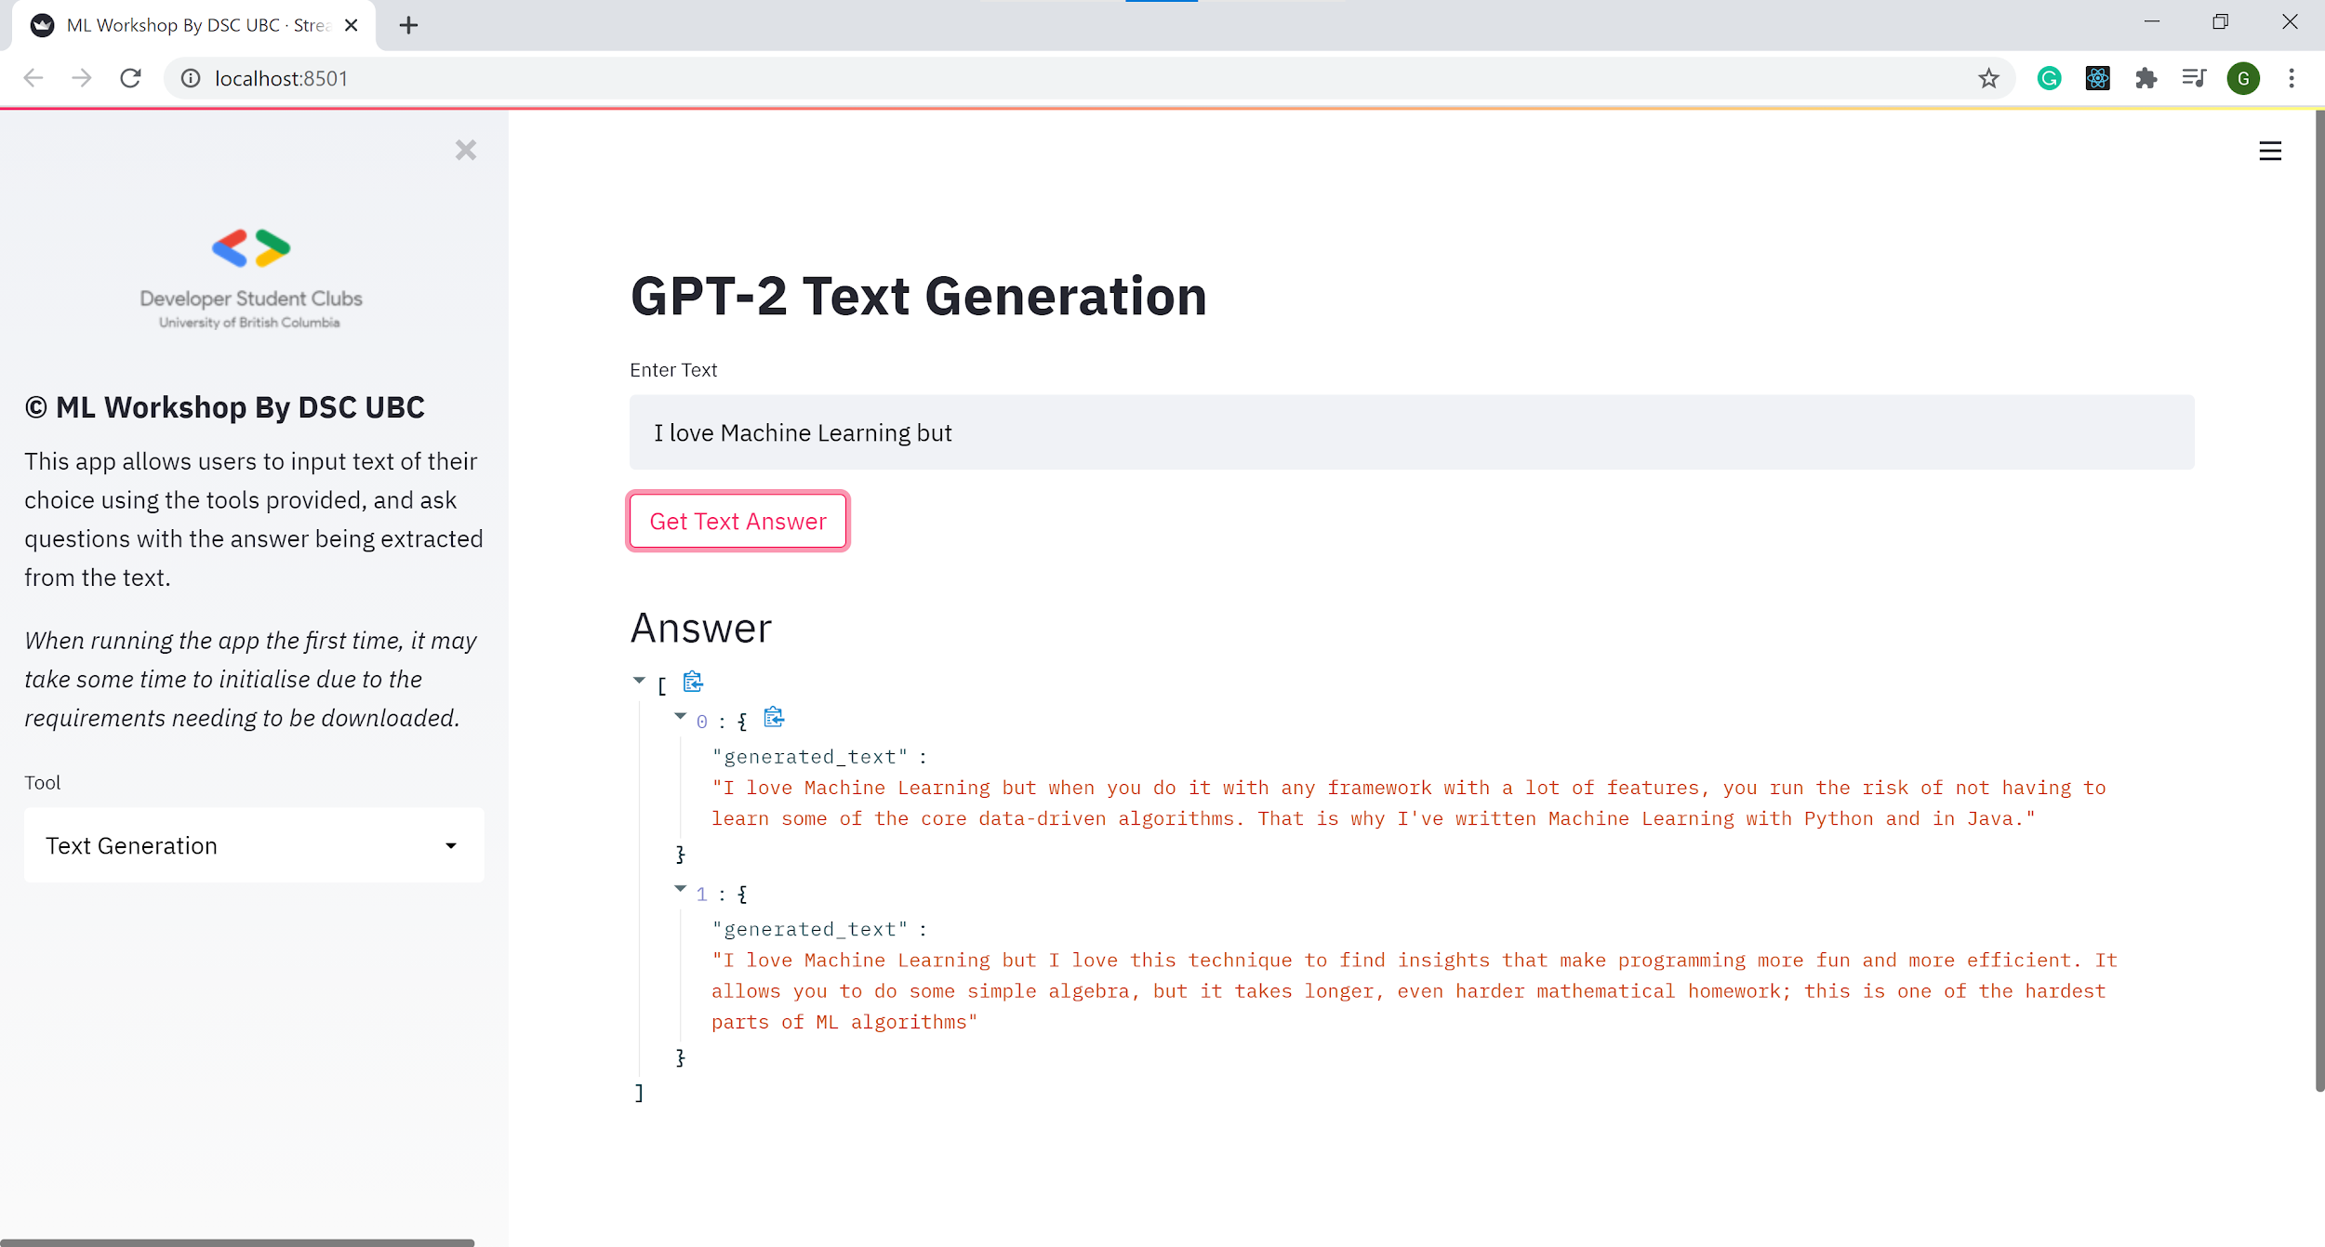
Streamlit
The fastest way to build and share ML webapps
Streamlit is an open-source Python library that makes it easy to create and share beautiful, custom web apps for machine learning and data science
pip install streamlit
streamlit run app.py

Slide 12
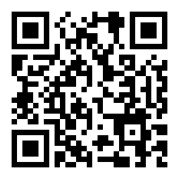

Demo:
Jupyter Notebook
https://github.com/ubcdsc/ML-Workshop

Slide 13
Demo: Practical Applications
https://github.com/ubcdsc/ML-Workshop

Slide 14
Q/A Session
Raise your hand or use the chat function to as a question. We’ll also be floating around in the discord if you have questions later too.

Slide 15
Resources to learn
Visit our workshop repo for useful links and resources.
https://github.com/ubcdsc/ML-Workshop

Slide 16
Thank You!
Upcoming Event
Solution Challenge Design Workshop Series
Solution Challenge
Stay in touch
ubcdsc.com/ - stay tuned for our new site!
@dscubc - follow us on instagram for updates

